Slide 1
Do You Know Who This Is?

Slide 2
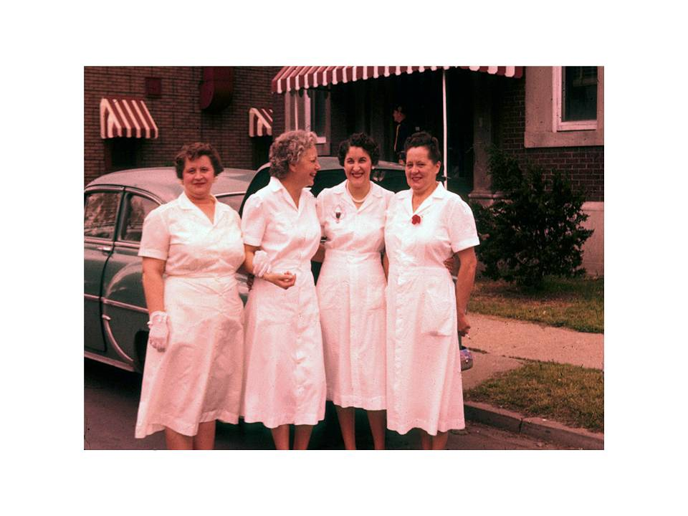

Slide 3
